Slide 1
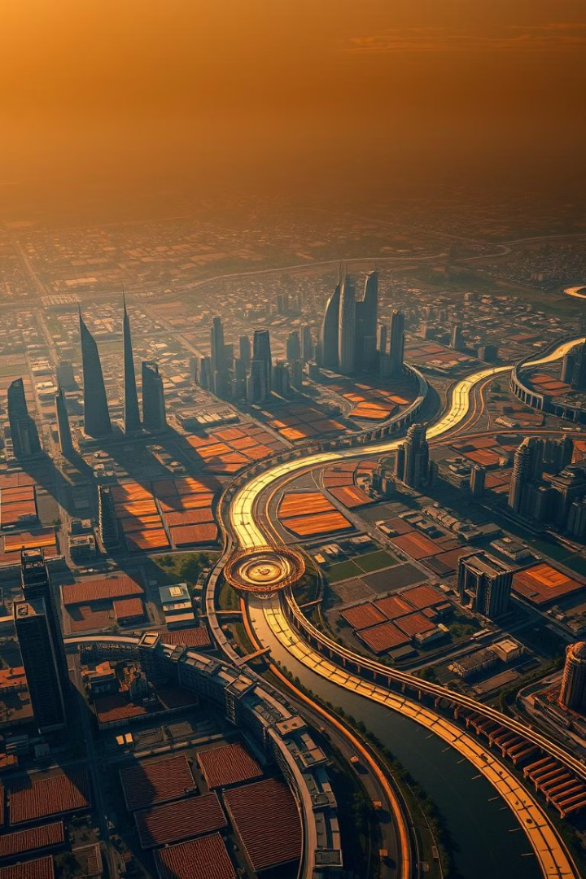
Socio-Economic Data Analysis of Uttar Pradesh
This presentation analyzes the socioeconomic data of Uttar Pradesh, offering insights into its demographics, economic trends, and development opportunities.

Slide 2
Overview of Uttar Pradesh: Population, Geography, and Economy
Population
Geography
Economy
With a population of over 240 million, Uttar Pradesh is the most populous state in India, accounting for about 17% of the country's total population.
Located in northern India, the state encompasses a diverse geography, ranging from the fertile plains of the Ganges River to the rolling hills of the Vindhya Range.
Uttar Pradesh is a major agricultural producer and has a significant industrial base. The state's economy is primarily driven by agriculture, followed by services and industry.

Slide 3

Demographic Trends: Population Growth and Urbanization
1
Uttar Pradesh has experienced significant population growth over the past few decades, driven by high birth rates and declining mortality rates.
2
Urbanization is another important demographic trend, with increasing migration from rural areas to cities. This creates challenges for infrastructure development and resource management.
3
The state's rapidly growing population presents both opportunities and challenges. It requires strategic planning and investments to ensure sustainable growth and development.

Slide 4

Unemployment and Wages Disparities
Unemployment Rates
Wages Disparities
Skills Gap
Uttar Pradesh faces significant unemployment challenges, particularly among youth and certain social groups, hindering economic progress.
There are substantial wage differences between different social groups, reflecting inequalities in access to education, training, and employment opportunities.
The widening skills gap between the demand for qualified workers and the availability of skilled workforce presents a significant obstacle to economic growth.

Slide 5

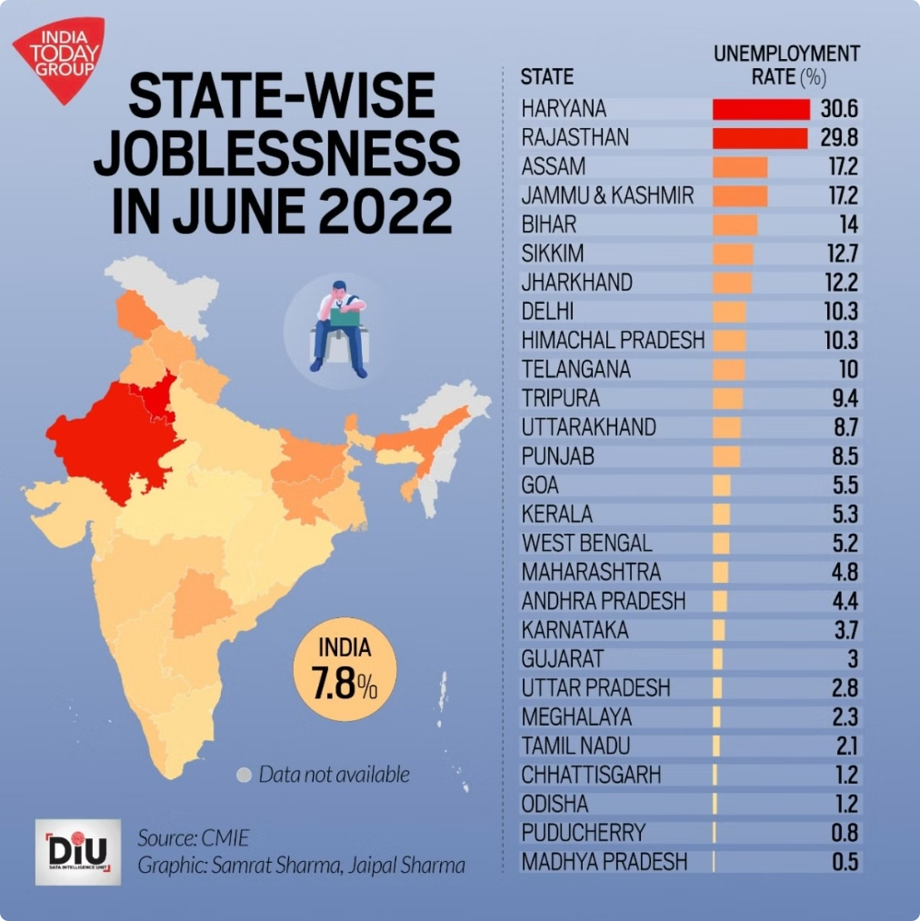



Trend of Unemployment and Wages Disparities from 2017 to 2024
In recent years, unemployment rates have fluctuated but have generally remained high in Uttar Pradesh, particularly in urban areas.
Wage disparities have also shown limited improvement, with significant differences persisting between different social groups and sectors.
Addressing these challenges requires a multi-pronged approach, including investing in education, skill development, and job creation initiatives.

Slide 6

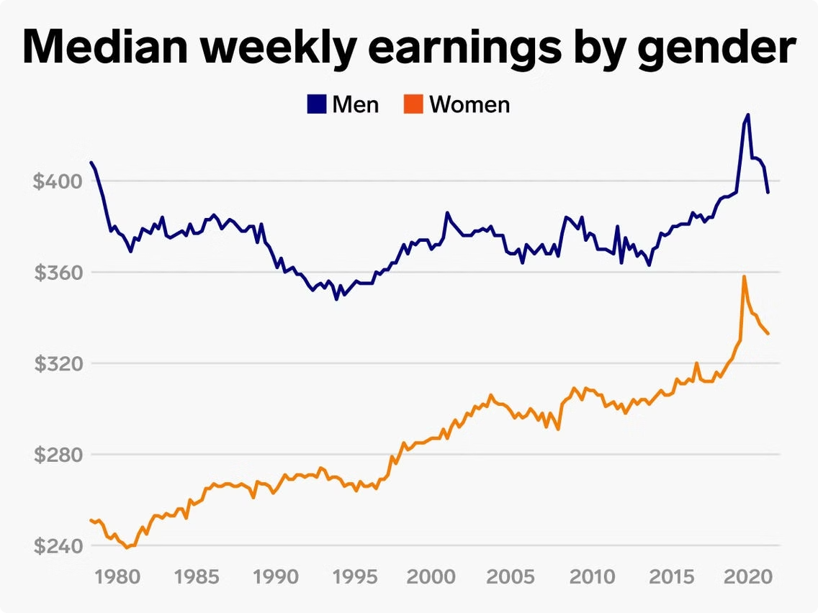


Gender Impact on Wages and Unemployment
Women
Men
Women in Uttar Pradesh experience higher unemployment rates and lower wages compared to men, indicating a significant gender gap in economic participation.
Men in Uttar Pradesh generally have better access to education, training, and employment opportunities, contributing to a higher participation in the workforce.

Slide 7

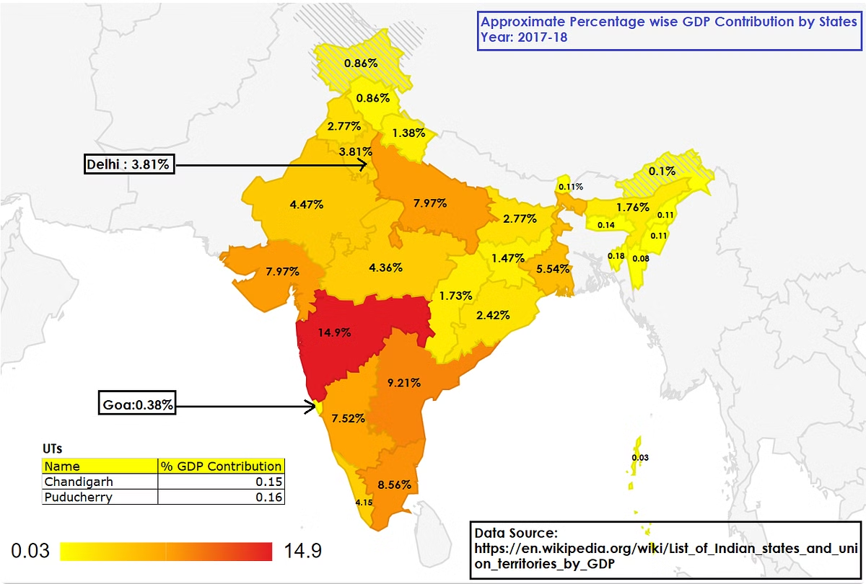
GDP contribution of Uttar Pradesh
24.5%
40%
Agriculture
Services
Agriculture remains the dominant sector in Uttar Pradesh's economy, contributing a significant share to the state's GDP.
The services sector is steadily growing in Uttar Pradesh, driven by increasing urbanization and demand for various services.
14%
Industry
While the industrial sector contributes a smaller share to GDP, it offers opportunities for growth and diversification.

Slide 8



Regional Disparities: Variations in Per Capita Income and GDP Contribution
Western Region
1
Western Uttar Pradesh has higher per capita income and GDP contribution due to a more developed industrial base and access to major markets.
Eastern Region
2
Eastern Uttar Pradesh has lower per capita income and GDP contribution, with a higher reliance on agriculture and limited industrial development.
Central Region
3
Central Uttar Pradesh falls somewhere in between, with a mix of agricultural and industrial activities contributing to moderate economic development.

Slide 9
Poverty Alleviation Initiatives and Multidimensional Poverty Index
National Rural Employment Guarantee Act (NREGA)
1
NREGA provides employment guarantee to rural households, contributing to poverty reduction and rural development.
Pradhan Mantri Awas Yojana (PMAY)
2
PMAY focuses on providing affordable housing to low-income families, improving living conditions and promoting social inclusion.
Swachh Bharat Abhiyan
3
Swachh Bharat Abhiyan aims to improve sanitation and hygiene in rural and urban areas, contributing to public health and well-being.

Slide 10

Future of the Project
The future of this project lies in leveraging data-driven insights to inform policy decisions, promoting inclusive growth, and addressing socioeconomic challenges in Uttar Pradesh. The project will continue to track key indicators and provide valuable insights for stakeholders. The project will also explore opportunities for partnerships and collaborations to accelerate progress towards a more equitable and prosperous Uttar Pradesh.

